Slide 1
What is an Atom made of?

Slide 2
Outline
Atomic Structure
How to Identify Atomic Structures

Slide 3
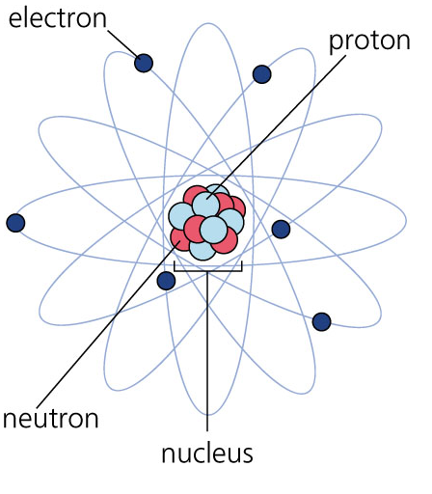

Atomic Structure
Atoms consist of three different subatomic particles:
  Protons
  Neutrons
  Electrons

Slide 4
Atomic Structure
Protons are located in the nucleus of an atom
Protons have a positive
charge

Slide 5
Atomic Structure
Neutrons are located in the nucleus of an atom
Neutrons do not have a
charge (neutral)

Slide 6
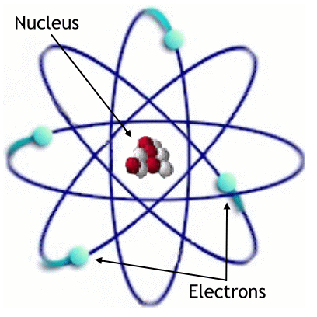
Atomic Structure
Electrons are located outside of the nucleus
Electrons have a
negative charge

Slide 7
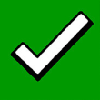
Outline
Atomic Structure
How to Identify Atomic Structures

Slide 8
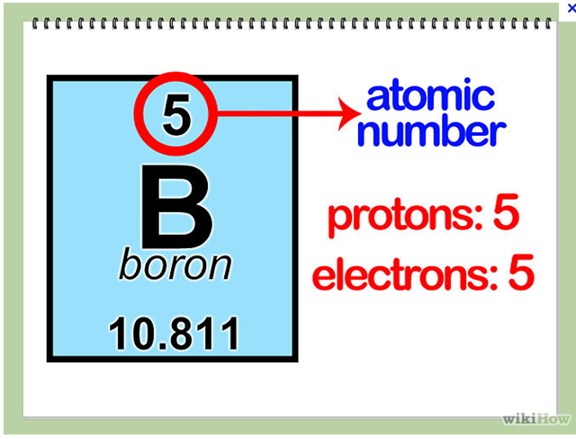
Protons
The # of protons is same as:
  The Atomic Number

Slide 9
Electrons
The # of electrons is same as:
  The Atomic Number

Slide 10
Practice:
First 20 Elements Worksheet
  Now complete the Part #2 information:
      Number of Protons, Number of Electrons
  Do questions for Part #2

Slide 11
First 20 Elements Questions
Part #2
  What do you notice about the number of protons and the number of electrons for each element?

